Slide 1

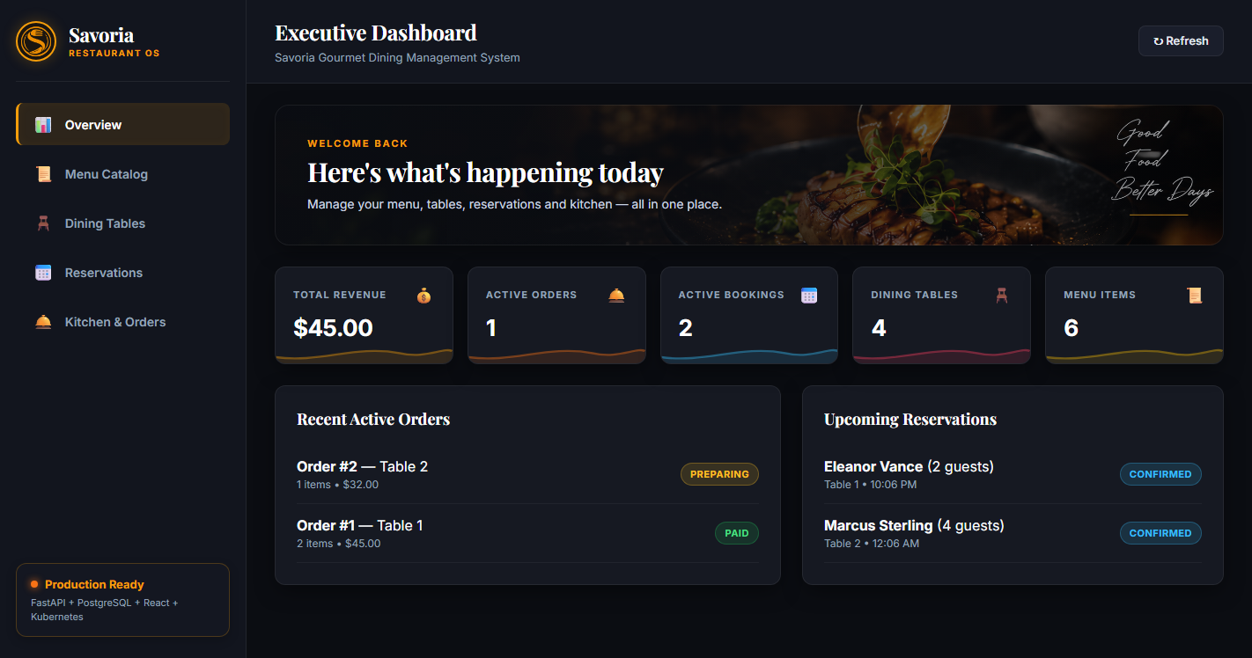
DEVOPS ENGINEERING CAPSTONE · SESSION 21
Savoria
Restaurant Management Platform
A cloud-native platform for menu catalog, dining floor, reservations and kitchen orders, delivered through the complete 10-module DevOps lifecycle.
Evidence: Savoria executive dashboard (React + Vite)
Author: M S Sayed (@MSSAYED11) | DevOps Engineering Capstone
Notes:
Introduce Savoria: a restaurant operations platform (menu, tables, reservations, kitchen orders). The project covers all ten capstone modules, from the application itself to Kubernetes and observability.

Slide 2
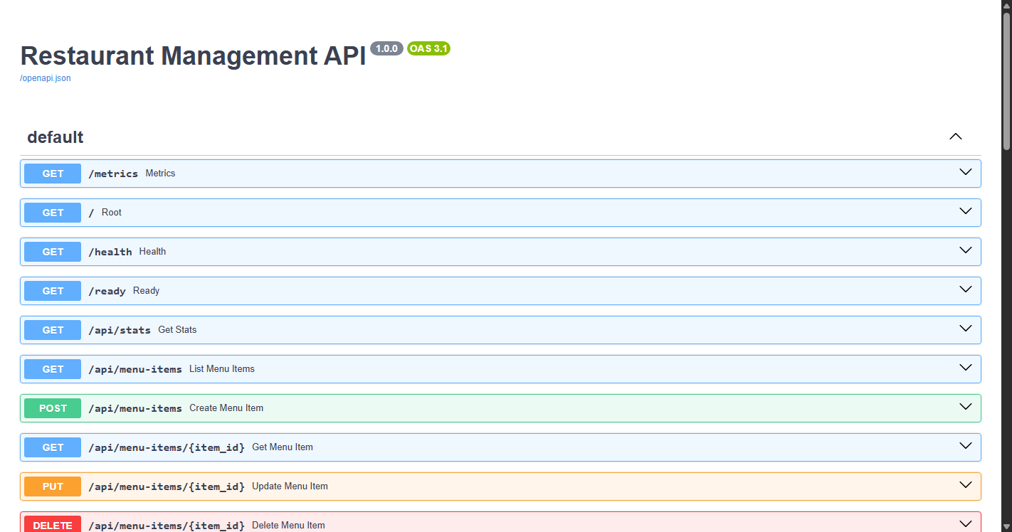
FastAPI Backend, PostgreSQL & React Dashboard
M1
MODULE 1 · APPLICATION CORE
Fulfilling M1 criteria: /health probe, 4+ REST endpoints, Alembic migrations and a React UI
1
Probes and 21 REST routes
/health, /ready and /metrics, plus full CRUD under /api for menu, tables, reservations and orders.
2
PostgreSQL with Alembic
PostgreSQL 16 schema versioned by Alembic; migrations run automatically when the backend starts.
3
Business rules in the API
Over-capacity bookings return 400, double-booking returns 409, orders follow PLACED to PAID.
4
Dark-luxury React UI
Vite/React app with live KPI cards, menu catalog, dining tables, reservations and kitchen orders.
Evidence: FastAPI Swagger UI at :8000/docs
Notes:
The backend exposes health, readiness and metrics probes plus CRUD for four entities. Business rules (capacity, double-booking, order state machine) live in the API, not just the UI.

Slide 3
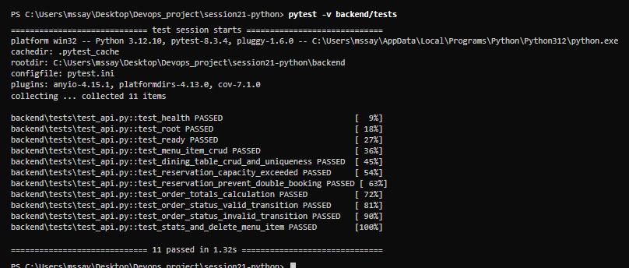
Automated Pytest Suite with an Isolated Database
M2
MODULE 2 · TESTING
Fulfilling M2 criteria: clean pytest -v run, 5+ test cases, isolated database and pytest.ini
1
11 test cases, all passing
Well past the 5-test minimum: health, ready, CRUD, capacity, double-booking and order tests.
2
Business-rule coverage
Tests cover capacity limits, double-booking prevention and valid versus invalid order transitions.
3
Isolated SQLite via conftest.py
SQLAlchemy dependency overrides keep every test off the PostgreSQL data.
4
Fast regression gate
11 passed in 1.32 s; the same suite is the first CI job and blocks image builds if it fails.
Evidence: pytest -v, 11 of 11 tests passing (1.32 s)
Notes:
Eleven tests run in about a second against an in-memory SQLite database, so production data is never touched. CI runs the same suite before any image is built.

Slide 4
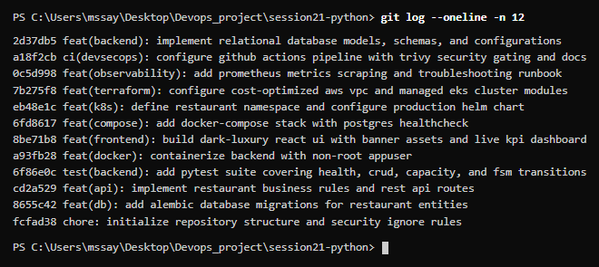
Conventional Commits & Repository Hygiene
M3
MODULE 3 · VERSION CONTROL
Fulfilling M3 criteria: 10+ meaningful commits, descriptive messages and a clean .gitignore
1
24 project commits
22 follow Conventional Commits with feat, ci, test, fix, docs and chore prefixes and scopes.
2
Scoped, meaningful messages
For example feat(db) for migrations, test(backend) for the pytest suite, feat(k8s) for the Helm chart.
3
Strict .gitignore
Excludes .env, keys, __pycache__, .venv, node_modules, Terraform state and tfvars files.
4
Secrets-free, modular repo
No credentials committed; backend, frontend, helm, terraform, k8s, monitoring and troubleshooting folders.
Evidence: git log --oneline -n 12
Notes:
The history shows the build order of the project, with one scoped commit per layer: database, API, tests, Docker, frontend, Compose, Kubernetes, Terraform, observability and CI.

Slide 5
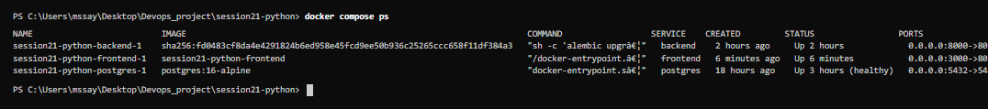
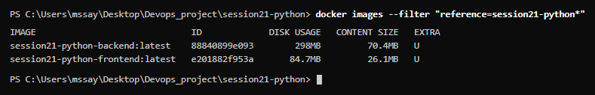
Non-Root Containers & a One-Command Compose Stack
M4
MODULE 4 · CONTAINERIZATION
Fulfilling M4 criteria: backend Dockerfile, multi-stage frontend, non-root users and Docker Compose
1
Multi-stage frontend build
Node 22 Alpine builds the Vite bundle; only static files are copied into nginx:1.27-alpine.
2
Non-root execution
Backend runs as appuser (UID 10001); the frontend runs as the nginx user on port 8080.
3
Single-command Compose
docker compose up --build starts backend, frontend and PostgreSQL 16 with a database healthcheck.
4
Lean images
Content size is 70.4 MB for the backend image and 26.1 MB for the frontend image.
Evidence: docker compose ps and docker images (full size in README)
Notes:
Both containers drop root. The frontend uses a multi-stage build so no Node toolchain ships in the final image. Compose brings up the whole stack with one command.

Slide 6
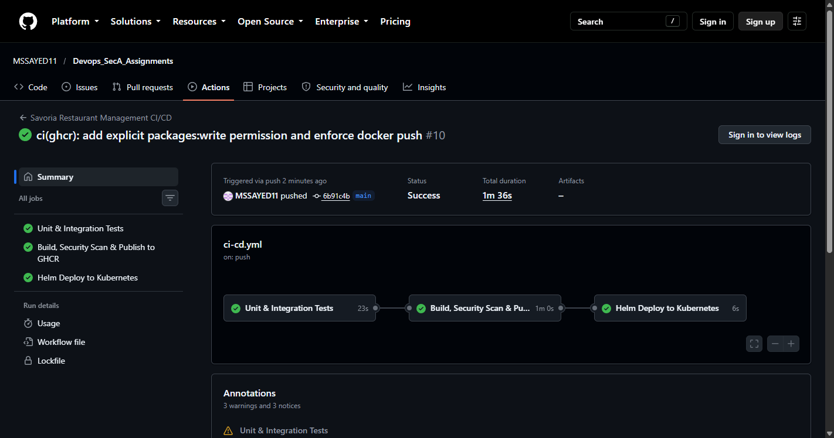
3-Job GitHub Actions Pipeline Publishing to GHCR
M5
MODULE 5 · CI/CD PIPELINE
Fulfilling M5 criteria: push-to-main trigger, pytest gate, frontend build and SHA-tagged GHCR images
1
Job 1: Tests (22 s)
Runs backend pytest and the Vite frontend build on every push and pull request to main.
2
Job 2: Build, Scan, Publish (1 m)
Builds both images, runs Trivy, then pushes to ghcr.io/mssayed11.
3
Commit-SHA image tags
Each image is pushed tagged with the full Git commit SHA, alongside a latest convenience tag.
4
Job 3: Helm deploy (6 s)
Runs helm upgrade --install with the SHA tag; skips safely if no cluster credentials are set.
Evidence: green pipeline run #10, 1 m 36 s total
Notes:
Three jobs run in sequence and each needs the previous one: tests, build plus scan plus publish, then a Helm deploy. Run number 10 finished green in 1 minute 36 seconds.

Slide 7
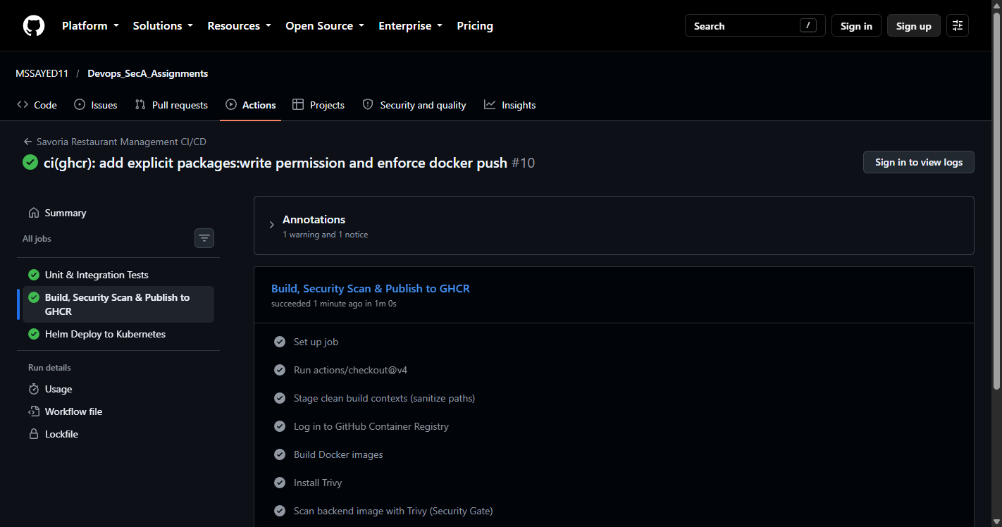
Trivy Container Vulnerability Scanning in CI
M6
MODULE 6 · DEVSECOPS
Fulfilling M6 criteria: Trivy scan on both images in CI, HIGH/CRITICAL severities and a written explanation
1
Both images scanned
Backend and frontend images are scanned with Trivy inside the CI job.
2
Scan runs before the push
The scan steps sit between the image build and the docker push to GHCR.
3
HIGH and CRITICAL focus
Flags --severity HIGH,CRITICAL --ignore-unfixed report fixable serious CVEs only.
4
Written explanation
trivy-explanation.md explains what is scanned and how to read the result.
Evidence: Trivy scan steps in the CI job log
Notes:
Trivy runs against both freshly built images before anything is pushed to the registry. It reports only high and critical vulnerabilities that already have a fix available.

Slide 8
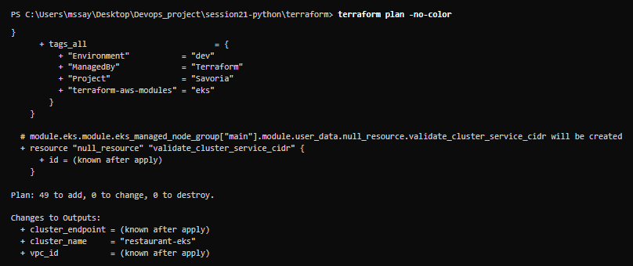
AWS VPC & Managed EKS Defined in Terraform
M7
MODULE 7 · INFRASTRUCTURE AS CODE
Fulfilling M7 criteria: valid HCL, VPC with 2 public subnets, EKS cluster and terraform.tfvars.example
1
Two-AZ VPC
10.20.0.0/16 VPC with two public subnets in ap-south-1a and 1b and no NAT gateway, to keep cost low.
2
Managed EKS cluster
EKS 1.31 control plane with a managed node group of two t3.small nodes.
3
Validated plan
terraform init and validate succeed; terraform plan reports 49 to add, 0 to change, 0 to destroy.
4
Secrets-free configuration
terraform.tfvars.example holds placeholders; state and tfvars files are git-ignored.
Evidence: terraform plan, 49 resources to add
Notes:
The infrastructure is cost-optimised: public subnets only, no NAT gateway, two small nodes. The plan was validated and reviewed; nothing here depends on committed credentials.

Slide 9
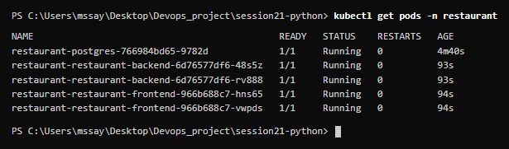
Helm Chart with Ingress Routing & Autoscaling
M8
MODULE 8 · KUBERNETES & HELM
Fulfilling M8 criteria: namespace.yaml, Helm chart, 2+ replicas, ClusterIP services, Ingress and Running pods
1
Helm chart for the whole app
helm/restaurant templates backend, frontend, PostgreSQL, Ingress, HPA and ServiceMonitor.
2
Namespace isolation
k8s/namespace.yaml creates the restaurant namespace that holds every workload.
3
Replicas and autoscaling
Two replicas each for backend and frontend; the HPA scales the backend 2 to 6 pods at 60% CPU.
4
Ingress host routing
NGINX Ingress on restaurant.local sends / to the frontend and /api to the backend (ClusterIP).
Evidence: kubectl get pods -n restaurant, all Running (local kind cluster)
Notes:
The chart was linted and deployed to a local kind cluster: five pods running, two backend, two frontend and one PostgreSQL. Ingress routes the UI and API by path.

Slide 10
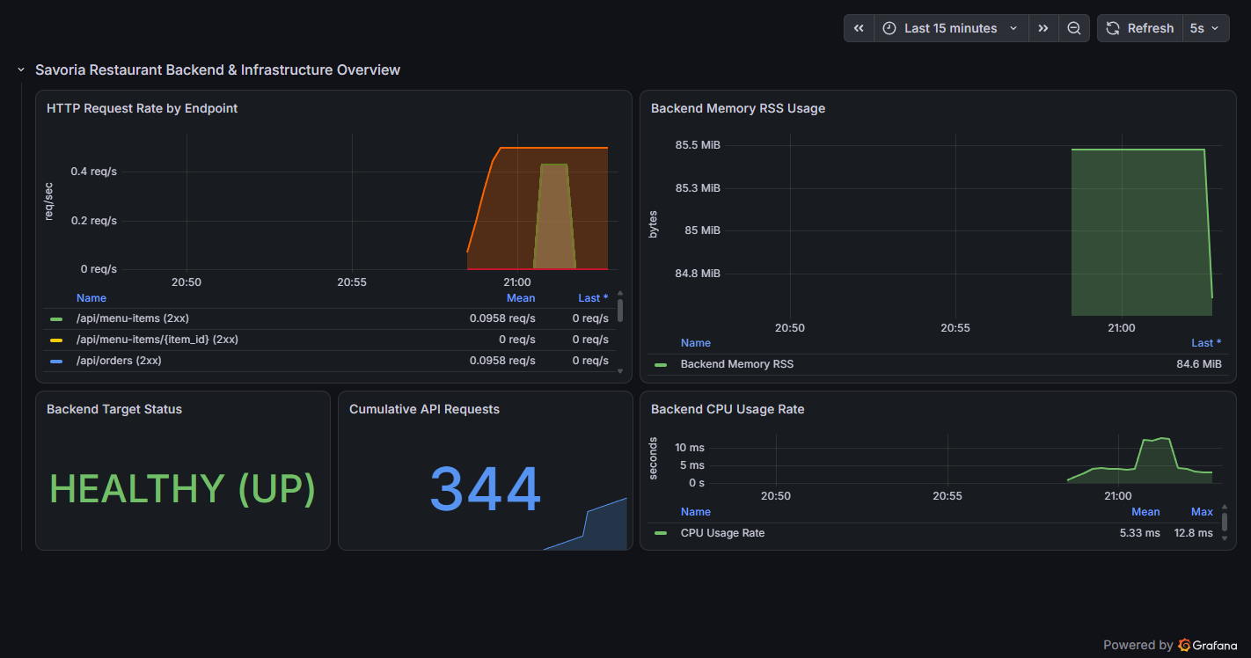
Prometheus Scraping & Grafana Dashboard
M9
MODULE 9 · OBSERVABILITY
Fulfilling M9 criteria: /metrics endpoint, Prometheus target UP and a Grafana dashboard with live panels
1
Metrics endpoint
FastAPI exposes /metrics; a ServiceMonitor is set to scrape it every 15 seconds.
2
Target verified UP
The Prometheus Targets page shows restaurant-backend with 1 of 1 targets up.
3
Live Grafana panels
Request rate by endpoint, memory (RSS), CPU usage, backend target status and total API requests.
4
Data from real traffic
The dashboard showed a HEALTHY (UP) backend and 344 cumulative API requests.
Evidence: Grafana backend and infrastructure overview
Notes:
Prometheus scrapes the backend and Grafana turns those metrics into request-rate, CPU, memory and health panels. The numbers on screen come from real requests to the running app.

Slide 11
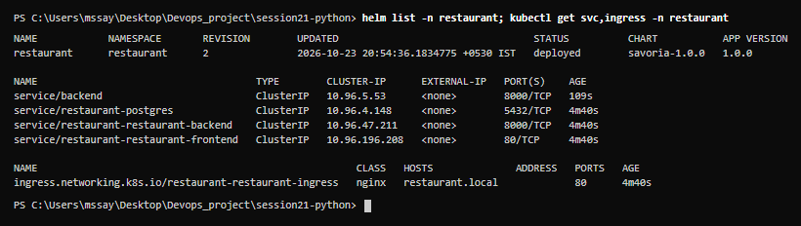
Troubleshooting Drills & Live Demo Readiness
M10
MODULE 10 · VERIFICATION
Fulfilling M10 criteria: professional README, failure-scenario exercises and a demo walkthrough
1
Drill 1: ImagePullBackOff
A pod with a non-existent tag; kubectl describe shows the pull error; fix by pinning a valid GHCR SHA tag.
2
Drill 2: Empty endpoints
kubectl get endpoints shows none; the Service selector matched no pods; fix by aligning the labels.
3
Complete documentation
README covers architecture, quickstart, CI/CD, Terraform, Helm and an M1 to M10 evidence table.
4
End-to-end demo flow
Commit, CI tests, Trivy scan, GHCR push, then Helm rolling update on the cluster.
Evidence: helm list and ingress for the restaurant release
Notes:
Two Kubernetes failure drills are documented with symptoms, diagnosis and fix. For the live demo, push a small change and follow it through the pipeline to a rolling update.

